Slide 1
RE for the Rest of Us: An Introduction to Reverse Engineering
Sydney Johns

Slide 2
About Me - Sydney Johns
PhD Student in Computer Science @ VT Innovation Campus
Intern on the Reverse Engineering team @ JHU APL
Researching post-quantum cryptography + side-channel attacks
Interests: Anime, Animal Crossing, Sims, Shopping

Slide 3
Agenda
Introduction
Hardware Reverse Engineering
Exercise - Chip ID on Arduino Boards
Software Reverse Engineering
Exercise – Flash Firmware to Arduino Uno
Tutorial – Analyze C Code in Ghidra
Takeaways

Slide 4
What is reverse engineering?
Reverse Engineering (RE) involves examining an existing item to extract technical data for reproduction.
The goal is to recreate the item functionally and dimensionally.
It requires physical access to the item—adequate stock is needed to begin the process.
Defense Logistics Agency. (n.d.). Reverse Engineering. Defense Logistics Agency Aviation. Retrieved July 14, 2025, from https://www.dla.mil/Aviation/Offers/Engineering/Reverse-Engineering/

Slide 5
Hardware Reverse Engineering
The process of disassembling and understanding a physical device or system. It involves taking apart the hardware to examine its components.
LaCASA. (n.d.). MSP430 software reverse engineering [Lecture notes]. University of Alabama in Huntsville. https://lacasa.uah.edu/images/Upload/teaching/cpe323/lectures/lw13_cpe323_MSP430_SoftwareReverseEngineering_Text.pdf

Slide 6
Step 0: Disassembly
Use specialized tools and a heat gun to carefully remove outer casing and components.
Document each step with photos for later reference.

Slide 7
Step 1: Identify Components
Inspect the board and note all part numbers.
Look up datasheets for each chip to understand function and pinout.
Use Google reverse image search or sites like Octopart for component identification.

Slide 8
Step 2: Locate Voltage and Ground
Use a multimeter to measure voltages at different points.
Identify power and ground pins.
Check for continuity to trace circuit paths.

Slide 9
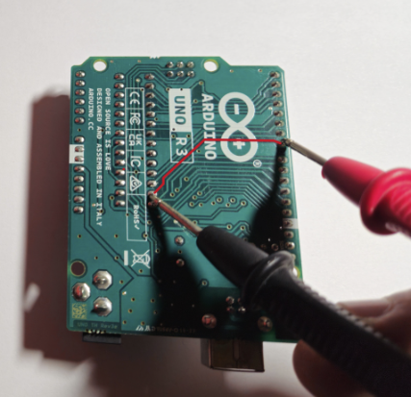
Exercise: Check Continuity
Flip the Arduino board over so you can see the soldered traces.
Choose a single trace or line to test.
Place one probe on each end of that line—where the pins or solder joints are.
Use a multimeter in continuity mode — if the line is intact, you'll hear a beep.

Slide 10
Step 3: Flash Dumping Prep
Identify memory chips or microcontrollers.
Look for connection points like test pads or headers.

Slide 11
Step 4: Locate Diagnostic Ports
Common diagnostic/debug ports: JTAG and UART
These may allow direct access to memory or system logs.
USB - B Socket: The USB socket on the UNO has two functions. One is for communication, to load the firmware into the Arduino with the help of the bootloader. The second is to power the Arduino.

Slide 12
Step 5: Dump and Analyze Flash
Use flash dumpers, SPI readers, or UART/JTAG tools to extract firmware.
Analyze firmware using static tools (Ghidra, binwalk) and dynamic testing environments.
Understand the system behavior and security posture from the firmware content.

Slide 13
Exercise: Catalogue IC Components
Look at your Arduino board
Pick one component (A, B, C, D)
Write down the part number printed on the chip.
Google the part number and find the datasheet.
You may also search on https://octopart.com/
Answer questions:
What does the chip do?
How many pins does it have?
What interfaces or protocols does it use?

Slide 14
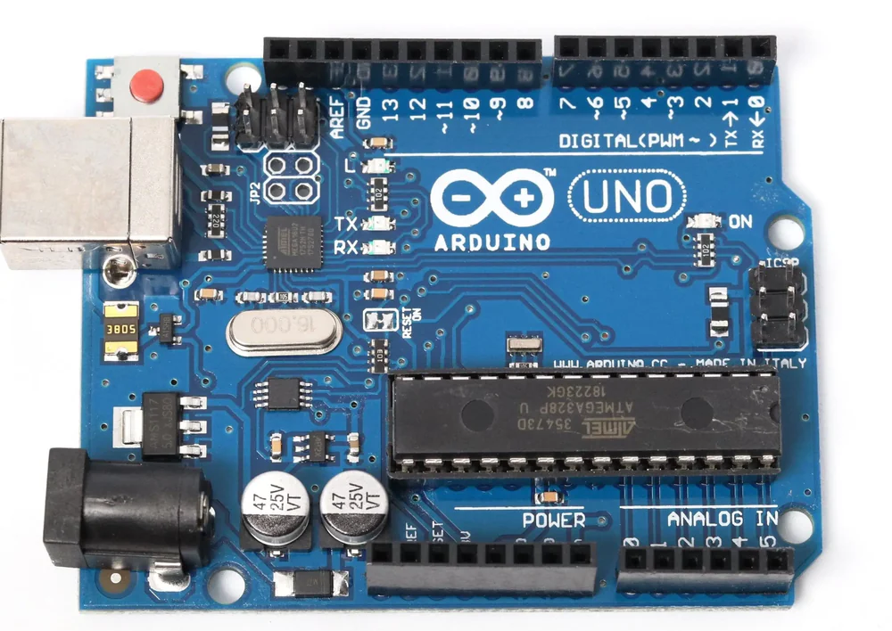
A
D
B
C

Slide 15
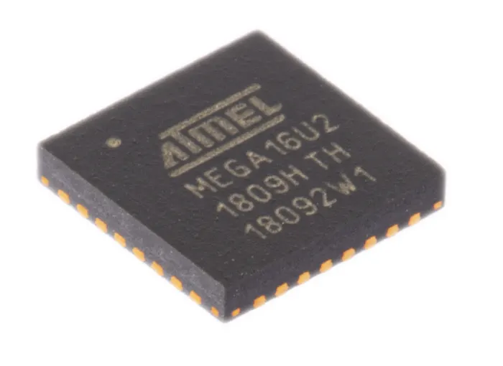
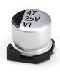
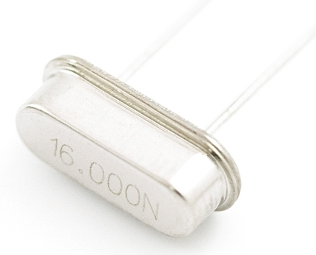
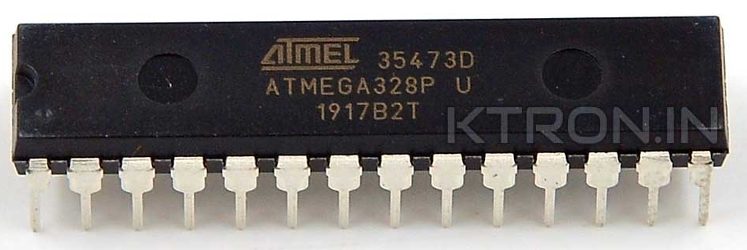
A
C
B
D

Slide 16
Solution: Catalogue IC Components
ATmega328/P
The brain of the Arduino Uno. It runs user code, handles I/O, and controls peripherals.
28 pins
UART (Serial), Digital I/O
16 MHz Crystal Oscillator
Provides the clock signal that drives the timing of the microcontroller.
2 pins
None — it's a passive timing component.
47 25V VT Capacitor
Smooths voltage, filters noise, or stores charge.
2 pins
None — it’s an analog timing component.
ATmega16U2
USB-to-serial converter
32 pins
UART (Serial), GPIO, USB
Datasheets available at: https://github.com/syd-kiwi/re-arduino-uno

Slide 17
Software Reverse Engineering
The process of examining and analyzing existing software to understand its structure, functionality, and design, often without access to the original source code.
Legal Information Institute. (n.d.). Reverse engineering. Cornell Law School. https://www.law.cornell.edu/wex/reverse_engineering

Slide 18
Step 1: Information Gathering
Collect all available artifacts: executables, binaries, config files, logs, firmware dumps, and any relevant documentation.

Slide 19
Step 2: Disassembly or Decompilation
Disassembly: Converts machine code into assembly (low-level but readable).
Decompilation: Attempts to recover a high-level source-like representation (e.g., C).
Tools: Ghidra, IDA Pro, Radare2, Hopper.

Slide 20
Step 3: Code Analysis
Static Analysis: Understand the code without executing it (e.g., control flow, functions, logic).
Dynamic Analysis: Run the program to observe behavior (e.g., tracing, breakpoints, debugging).
Goal: Reconstruct algorithms, logic, and architecture.

Slide 21
Step 3: Code Analysis
In this section we want to identify…
Entry point (main)
Functions and control flow
Strings, constants, and memory access
Variables and register usage

Slide 22
Step 4: Documentation
Record findings using diagrams, comments, and structure charts.
Common tools: Flowcharts, call graphs, data flow diagrams, and pseudo-code

Slide 23
Exercise: Flash Software onto Arduino
Go to my repo: https://github.com/syd-kiwi/re-arduino-uno
Download Arduino-test.ino file
Open https://cloud.arduino.cc/
Select Get Started Free > Create Account
Create New > Sketch
File > Add > Import File > Arduino-test.ino
Plug in the board to your computer
Select Device > Compile with Check Box > Flash with Arrow

Slide 24
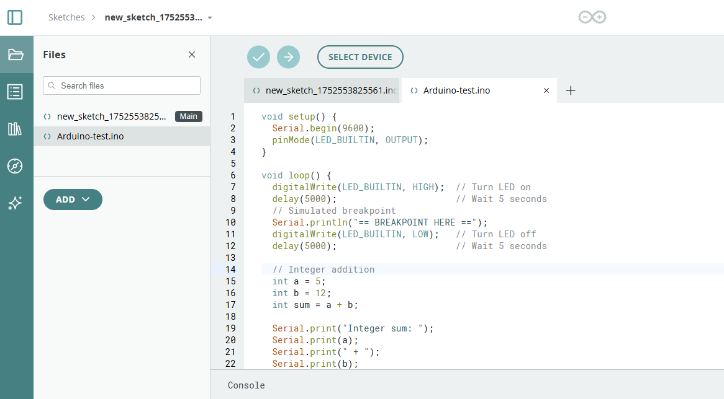

Slide 25
Tutorial: Analyze C Code in Ghidra
Those interested can download Ghidra here & try: https://github.com/NationalSecurityAgency/ghidra/releases
Locate the main() function in the decompiler
Identify:
Integer addition: int a = 5; int b = 12; int sum = a + b;
LED control via digitalWrite(LED_BUILTIN, HIGH/LOW)
Delay functions (look for timing-related calls)
Hex addition:0x03 + 0x07, and 0x04 + 0x0A
Observe how variables are mapped to registers or memory

Slide 27
Tips & Takeaways
Learn a few popular tools—Ghidra, Binwalk, QEMU, and GDB—Most come preinstalled on Kali Linux and make excellent resume builders.
You don’t need to be an expert — if you can write simple C, you can start reversing it and doing independent projects.
Practice makes patterns — the more you reverse, the more familiar code and circuit behaviors will become.
Document, document, document …. your process.
Notes:
Learn a few popular tools—Ghidra, Binwalk, QEMU, and GDB—which help bridge the gap between machine code and human-readable code. Most come preinstalled on Kali Linux and make excellent resume builders.
You don’t need to be an expert — if you can write simple C, you can start reversing it and doing independent projects.
Always document your reverse engineering process. Notes, screenshots, and code comments make it easier to replicate, explain, and improve your work.
Practice makes patterns — the more you reverse, the more familiar code and circuit behaviors will become.

Slide 28
Thank you
Sydney Johns
https://www.linkedin.com/in/sydney-johns/

